Slide 1

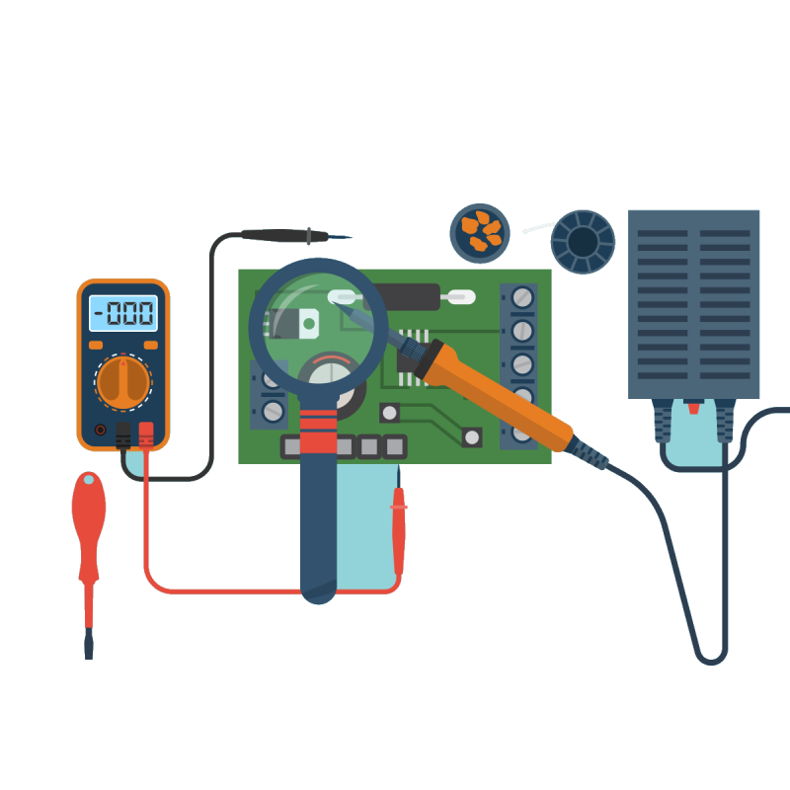
Hardware Validation
Hardware testing is the process of verifying that your hardware components and systems meet the specified requirements and function as expected.

Slide 2

Members
Muhammad Ali Jauhar (22I-1705)
Abdul Hadi (22I-1646)
Abdul Moeez (22I-1637)

Slide 3
Hardware Testing
Hardware testing is the process of verifying that your hardware components and systems meet the specified requirements and function as expected.

Slide 4
Hardware Validation
Hardware validation is the process of confirming that your hardware solutions satisfy the intended use and needs of your end users and customers. Validation is important for ensuring the quality and reliability of your hardware products, but they have different goals and methods.
1.Verification Validation:
Verification validation is the process of confirming your hardware products meet the design specifications and comply with standards and regulations

Slide 5
Hardware Validation
1.Verification Validation:
Verification validation is the process of confirming your hardware products meet the design specifications and comply with standards and regulations
2. Qualification Validation
Qualification validation is the process of determining if your hardware products are suitable for the intended use and environment.

Slide 6

Hardware Validation
2. Qualification Validation
Qualification validation is the process of determining if your hardware products are suitable for the intended use and environment.
Quick Rundown of Hardware Validation
1.Verification Validation:
Verification validation is the process of confirming your hardware products meet the design specifications and comply with standards and regulations

Slide 7

Quick Rundown of Hardware Validation
To get a deeper understanding of what hardware validation entails, we should look at real life case. Let’s take the example of a digital thermometer:
Defining specification and requirements: In this we set the scope for the product, in our case, we decide upon the required temperature range, the response time, accuracy, sensitivity, and power consumption.
Hardware Validation

Slide 8


Quick Rundown of Hardware Validation
Verifying/Reviewing Design: We’ll then review the product’s schematics and overall layout and ensure that it meets our required specifications.

Slide 9

Quick Rundown of Hardware Validation
Testing: Now we’ll put the product to the practical phase and see if the theory matches with the practice, for that we’ll put the product through a series of tests that will show the product’s limits.
Example of tests include Component testing, Manufacturing testing, Compatibility testing, thermal testing and Reliability testing.

Slide 10
Quick Rundown of Hardware Validation
Analysis and Documentation: Then we’ll summarize our results in the form of a report that provides evidence that the product does meet our requirements.

Slide 11

Application In Other Fields
In the semiconductor industry, hardware validation is used to verify that integrated circuits (ICs) meet their design specifications. This includes testing the IC's functionality, performance, power consumption, and reliability.
In the tech industry, hardware validation is used to verify that computers meet their performance and compatibility requirements. This includes testing the computer's processor, memory, storage, and peripherals.
In the medical device industry, hardware validation is used to verify that medical devices are safe and effective. This includes testing the device's functionality, biocompatibility, and sterility.

Slide 12
Thank You

